Slide 1
Containers

Slide 2
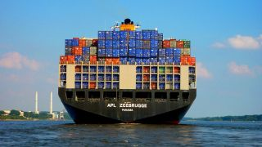
What are Containers?
A way to package application with all the necessary dependencies and configuration.
Portable artefact, easily shared and moved around
Makes development and deployment more efficient

Slide 3
Container Overview
Bundled into one package. It consists of
An Application
All its dependencies, libraries and other binary files
Configuration files that are needed to run it.

Slide 4
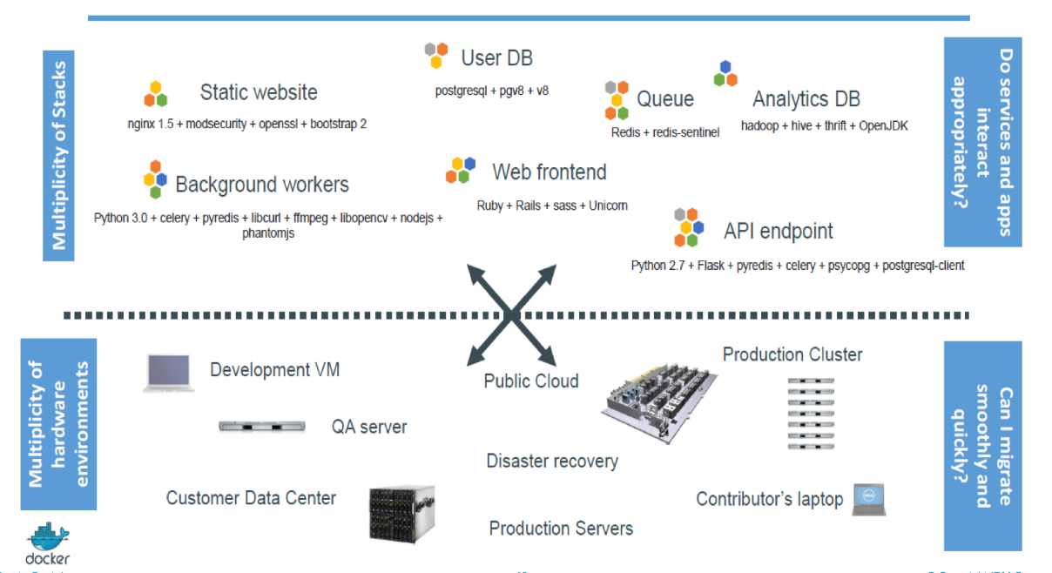
Challenge
Dependency Matrix
Application Maturity
Integration Challenges
Application ready for Cloud

Slide 5
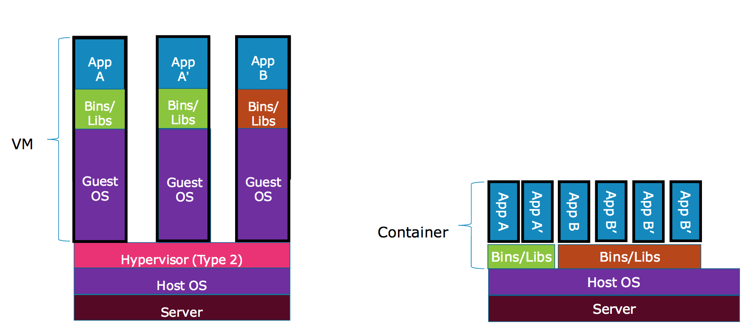
Containers – Comparison

Slide 6
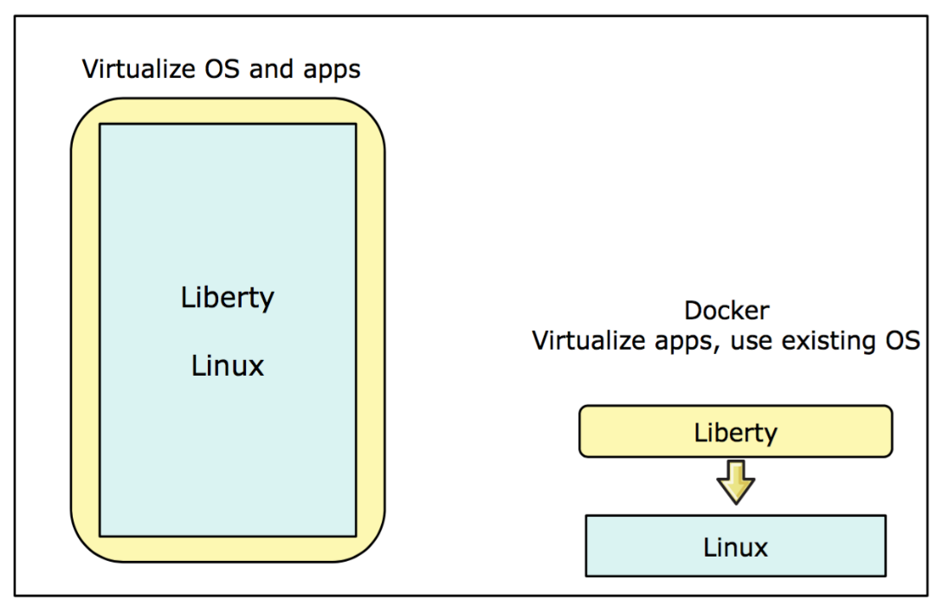
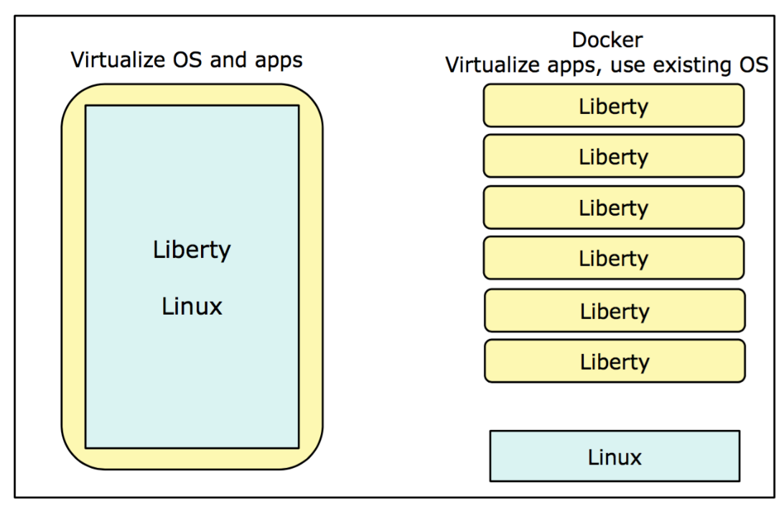
Containers – Comparison

Slide 7
History of Containers
1979 - Unix V7
2000 - FreeBSD Jails
2001 - Linux VServer
2004 - Solaris Containers
2005 - Open VZ (Open Virtuzzo)
2006 - Process Containers
2008 - LXC
2011 - Warden
2013 - LMCTFY
2013 - Docker
2017 - Container Tools Mature
2019 - Containerd and CRI-O

Slide 8
Benefits of Container
Less overhead
Increased portability
More Consistent operation
Greater efficiency
Better application development

Slide 9
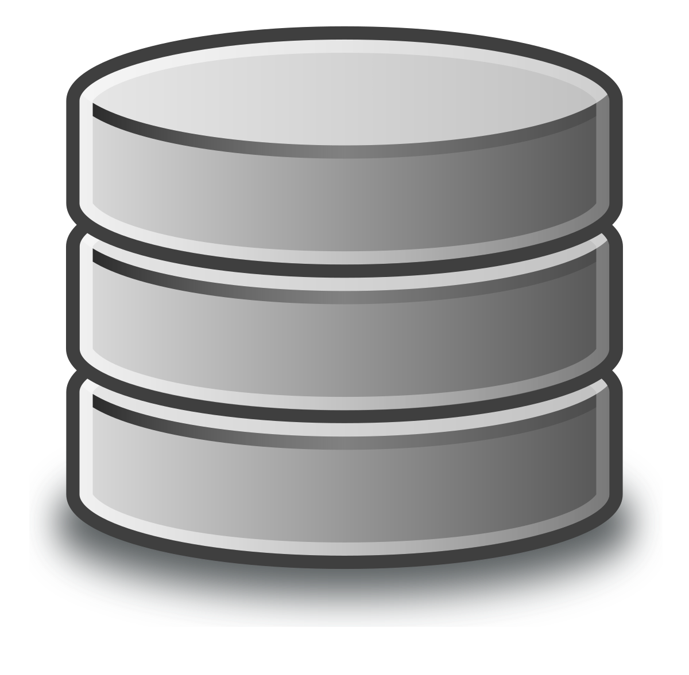


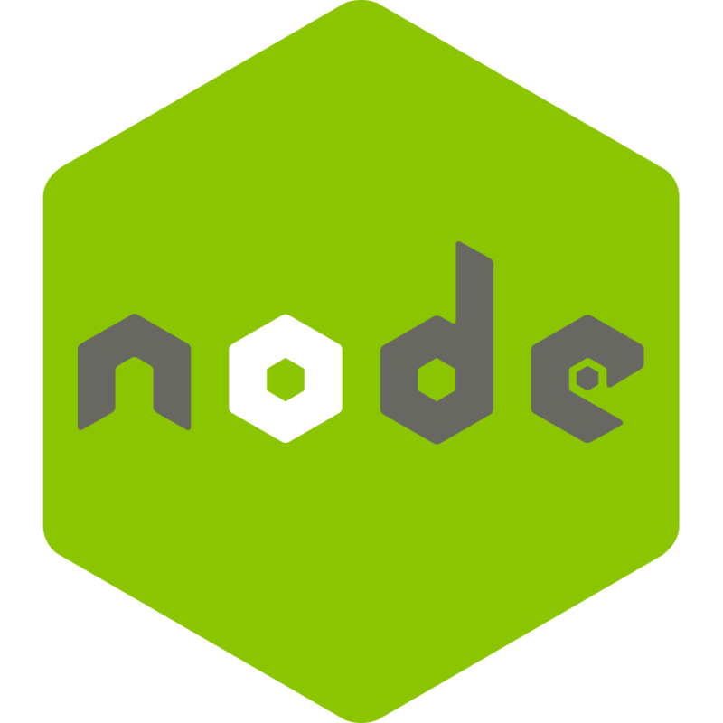
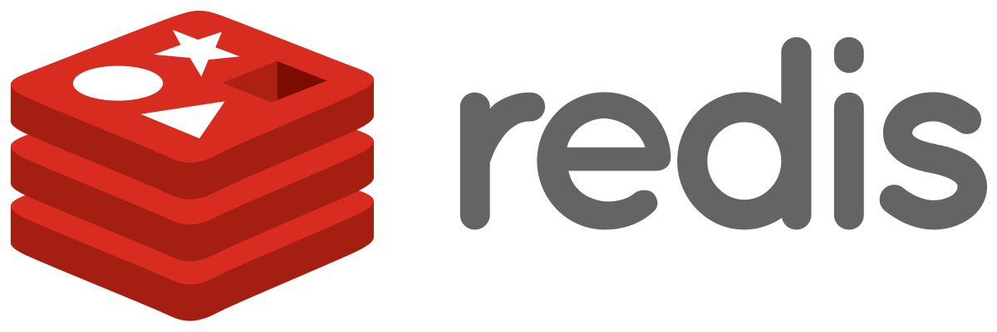
Where do containers Live?
Some Storage
Container Repository
Private Repository
Public Repository
Container Repository
Docker Hub

Slide 10

Application Development Process
Before Containers
Installation process different on each OS environment.
Many steps
Developers

Slide 11
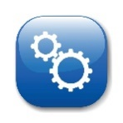
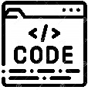
Application Development Process
With Containers
Own isolated environment.
Packaged with all configuration
One command to install the app
Run same app with different versions
Container
Config
Start Script

Slide 12

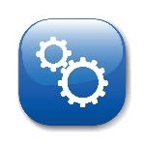
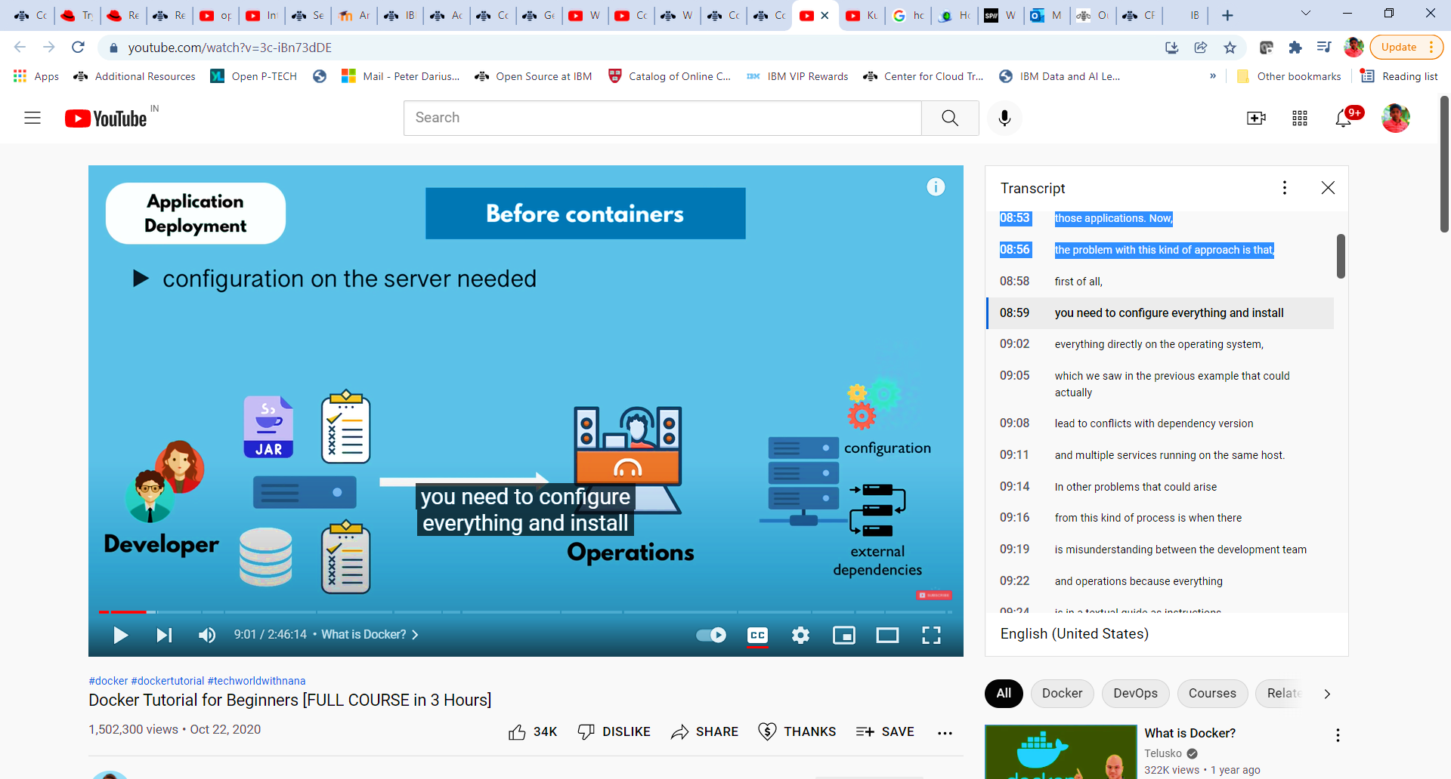

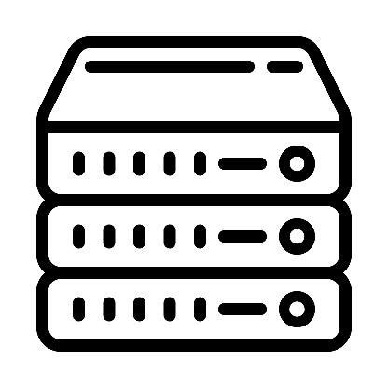
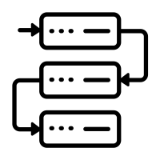
Application Deployment Process
Before Containers
Configuration on the server is needed
Dependency version conflicts
Textual guide of Deployment
Misunderstandings
Configuration
Operations
External Dependencies
Developers

Slide 13
Application Deployment Process
With Containers
Developers and Operations work together
No environment configuration needed - Except Docker runtime
Containers
Java App
Container
Developers
Configuration
Pull
Dependencies
Operations

Slide 14
Container Standards
Docker
Rocket
Garden from Cloud Foundry
Open Container initiative

Slide 15
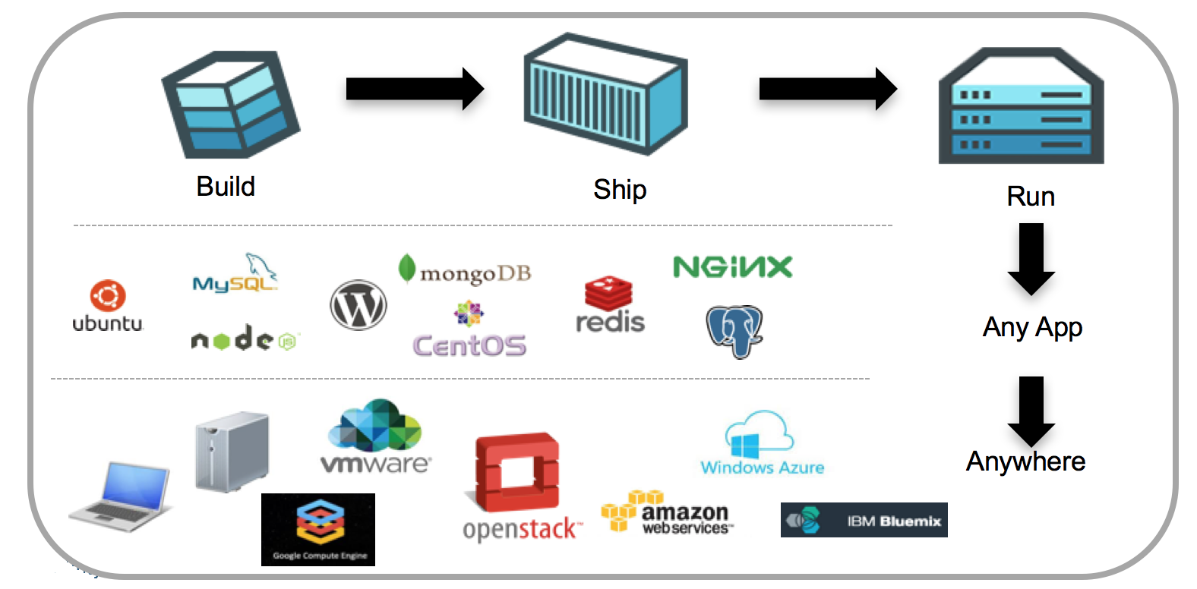
Docker
Docker is an open platform for developing, shipping, and running applications
Manage your infrastructure
Reduce the delay

Slide 16
Docker
Docker provides tools and a platform to manage the lifecycle of your containers:
Encapsulates your application.
Distribute and ship
Deploy those application

Slide 17
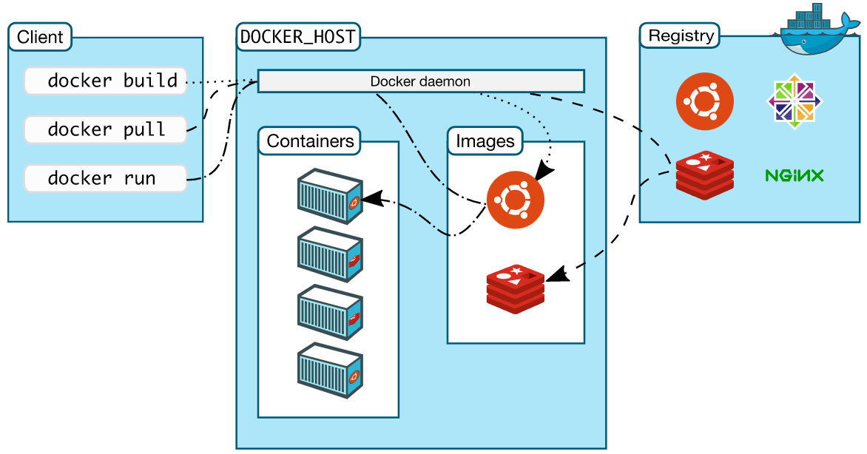
Docker Architecture

Slide 18
Docker Components
Image
Container
Docker hub/Registry
Docker Engine
Dockerfile

Slide 19
Docker Image
A read only snap shot
Read only layers
Light weight, standalone executable package

Slide 20
Container
Standard in which the application resides.
Created from an Image.
Containers isolate software from its surroundings.

Slide 21
Docker Hub/Registry
Software distribution mechanism know as “Registry”
Public, free registry called Docker Hub.
Container images are published and stored.
Types of Registry
Public
Private
Registry comes with a set of come API
Official images are certified by Docker.

Slide 22

Docker Engine
Creates, ships and runs
Run on any physical and virtual machines
Client communicates with engine to execute commands
Docker daemon = Docker engine
Docker Engine Components
Docker Daemon
API
CLI

Slide 23
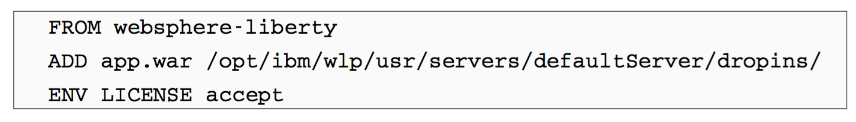
Dockerfile
A simple, descriptive set of steps that are called instructions, which are stored in a Dockerfile
An image is defined in the Dockerfile
Contents of a docker file are commands

Slide 24
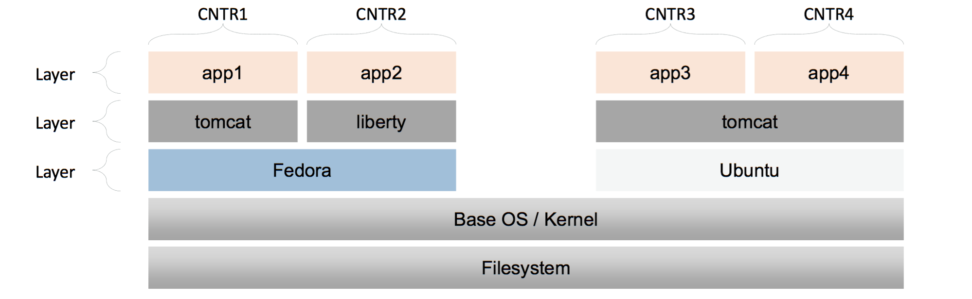
Docker Containers
Docker images are read-only templates
Docker uses union file system to combine these layers.
Top layer is writable container layer.
When the container is deleted, the writable layer is also deleted.
Containers that are derived from the same image are identical to each other.

Slide 25
What is container ? - Technically
Layers of Image.
Mostly Linux Based image
Application image on top
Postgre:10.10
Layer – Application Image
Alpine:3.10
Layer – Linux based image

Slide 26
Image vs Container
Image
Container
The actual package
Artifact that can moved around
Actually start the image
Container environment is created

Slide 27


Image vs Container
Container is a running environment for IMAGE.
Application image: nginx, redis, mongo ……..
Port binded: Communication to the application.
Container
Virtual file system
Application Image
File System
Configuration

Slide 28
Container Port vs Host Port
Multiple Containers can run on your Host machine.
Your machine has only certain ports available.
Conflict when you bond same port on host machine.
Port 5000
Port 3000
Port 3001
Host Machine
Port 5000
Port 3000
Port 3000

Slide 29
Orchestration
Orchestration is the automated configuration, management, and coordination of computer systems, applications, and services. Orchestration helps IT to more easily manage complex tasks and workflows.

Slide 30
Docker Orchestration
Managing Docker Containers at large Scale.
Options for Docker Orchestration
Kubernetes
Swarm
Cloud Container Platforms

Slide 31
Container Orchestration
Provisioning
Managing availability
Auto Scaling
Performing Load balancing
Monitor the health
Managing persistent storage

Slide 32
Container Orchestration
The key concepts of container orchestration are
Cluster Management
Schedule Management
Service Discovery
Replication
Health Management

Slide 33
Kubernetes
Kubernetes is a portable, extensible, open-source platform for managing containerized workloads and services, that facilitates both declarative configuration and automation.

Slide 34
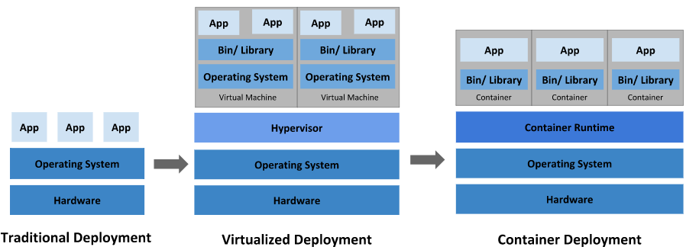
Why Kubernetes

Slide 35
Why Kubernetes?
Agile application creation and deployment.
Continuous development, integration and deployment.
Dev and Ops.
Observability.
Environment consistency.
Cloud and OS distribution portability.
Application-centric management.
Micro-services
Resource isolation
Resource utilization

Slide 36
Kubernetes – What it can do
Service discovery and load balancing
Storage orchestration
Automated rollouts and rollbacks
Automatic bin pakcing
Self-healing
Secret and configuration management

Slide 37
Kubernetes – what is not?
Does not limit the type of applications
Does not deploy source code
Does not build your applications
Does not provide application level services
Does not dictate logging, monitoring or alerting solutions.

Slide 38
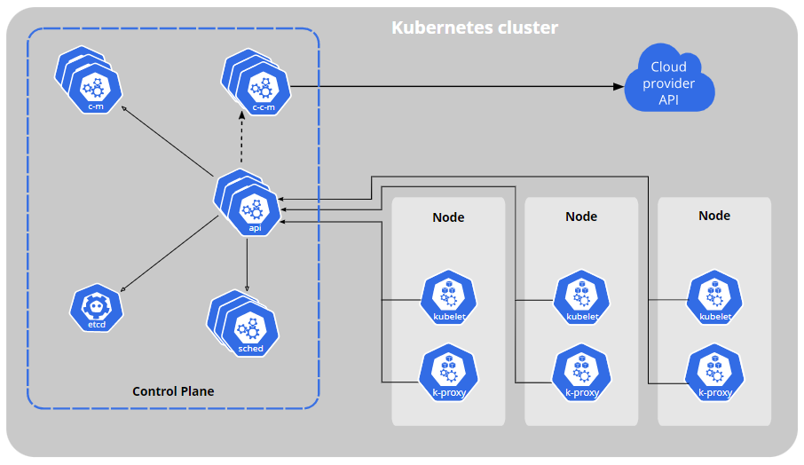
Kubernetes Components
Kubernetes Component
Worker Machine
Control Plane Components
Kube-apiserver
Etcd
Kube-scheduler
Kube-controller-manager
Cloud-controller-manager
Node Components
Kubelet
Kube-proxy
Container Runtime
Addons
DNs
Web UI
Container Resource Monitoring
Cluster-level Logging

Slide 39
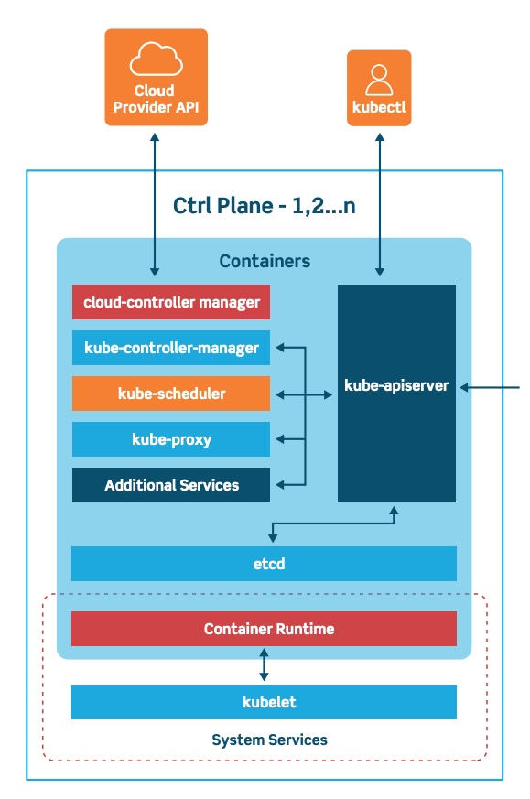
Cluster Architecture : Control Plane (Master)
Maintains a record of all kubernetes object
Continuously manages object state.
Three major components
Kube-apiserver
Kube-controller-manager
Kube-scheduler

Slide 40
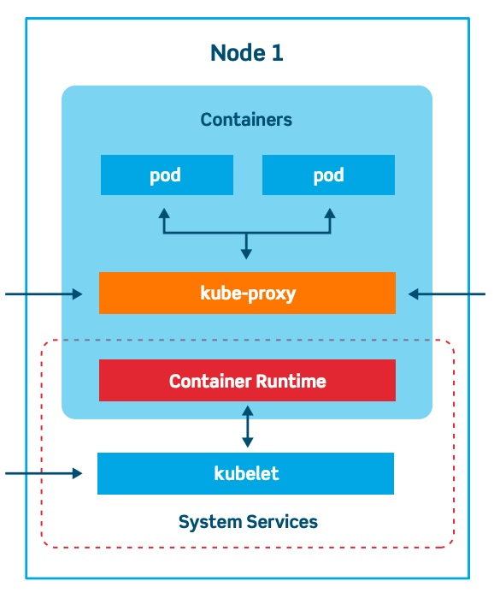
Cluster Architecture : Cluster Nodes
Machines that run containers
Major components
Kube-proxy
Kubelet
Container runtime
Docker running on a subnet

Slide 41
Cluster Architecture : Scheduler
Where to host the new Pods in the cluster
Two kinds of State
Desired state
Actual State

Slide 42
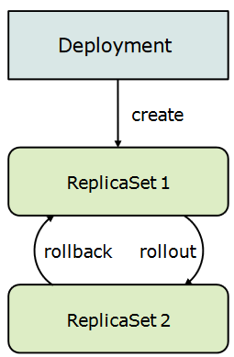
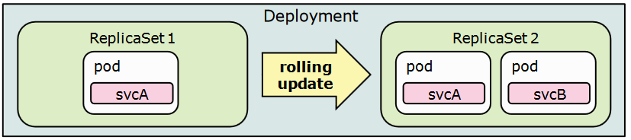
Types of Pod
ReplicaSet
Deployment
Daemonset
StatefulSet
Job and CronJob

Slide 43
Volumes
Allow a state to persist across Pods.
Types of volumes:
emptyDir
hostPath
Cloud volumes
NFS
PVC

Slide 44
PV and PVC
Persistent volume:
A piece of storage that has been provisioned by the administrator.
PVs are volume plugins.
Persistent Volume Claim:
A request for storage by the user.
Similar to pod.
PVCs consume PV resources.
PVs can be provisioned in two ways: statically or dynamically.

Slide 45
Storage Class
A StorageClass provides a way for administrators to describe the "classes" of storage they offer.
Fields used in StorageClass Resource
Provisioner
Determines what volume plugin is used for provisioning PVs.
Parameters
Describes volumes belonging to the Storage Class.
ReclaimPolicy
Specifies a reclaimPolicy, can be either Delete or Retain.

Slide 46
Service
Pods that is exposed as an endpoint
Types of service are
ClusterIP
NodePort
LoadBalancer
ExternalName

Slide 47
Helm

Slide 48
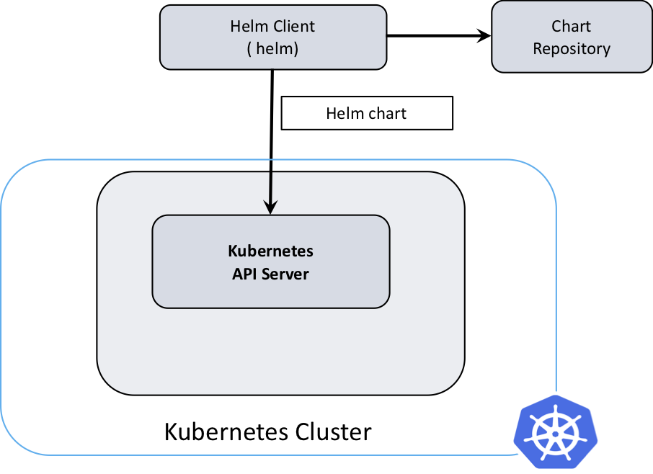
Overview
Helm is a tool that streamlines installation and management of Kubernetes applications.
Uses a packaging format called Charts.
Helm 3 is pivoted from Helm 2 Client – server architecture.
Helm is the client

Slide 49
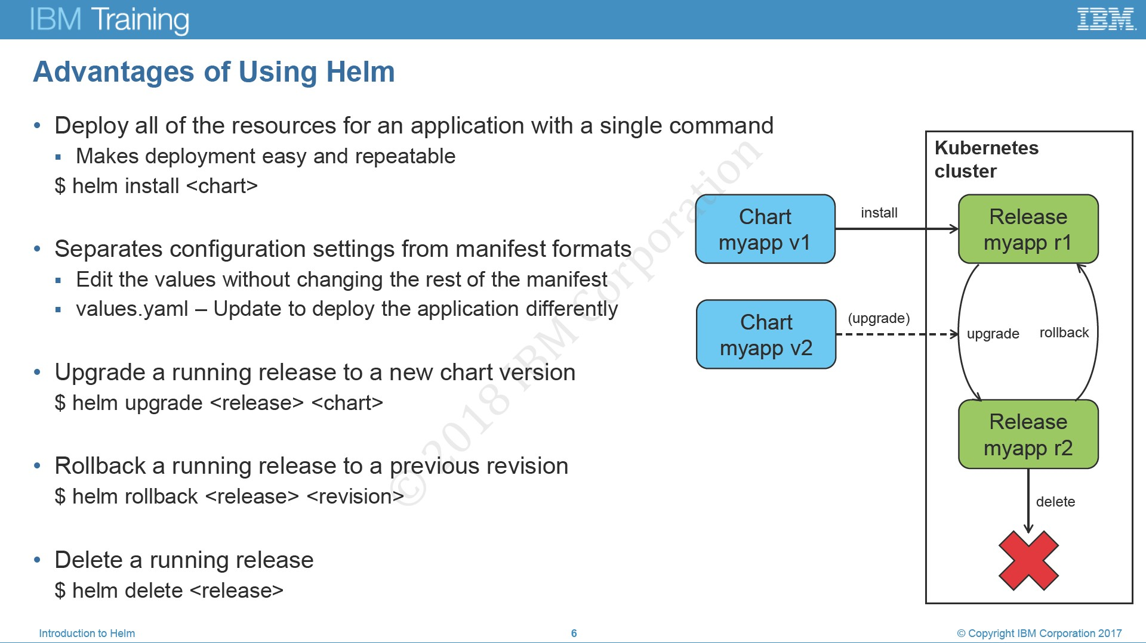
Advantages of using Helm

Slide 50
Helm Abstraction
Chart
Contains all of the resource definitions
Config
Contains configuration information
Helm – Helm Client
Renders charts into manifest files
Release
An instance of a chart running
Repository
Place where charts reside

Slide 51
Purpose of Helm
Create
Package
Interact
Install and Uninstall
Manage

Slide 52
Concepts
For Helm, there are three important concepts
Chart
Config
Release

Slide 53
Components
Two distinct parts:
Helm Client
Command line client
Responsible for
Development
Managing Repositories and Release
Interfacing with the Helm Library
Helm Library
Provides logic for executing all Helm operations
Responsible for
Combining Chart and configuration
Installing Charts
Upgrading and Uninstalling

Slide 54
Kubernetes Operator

Slide 55
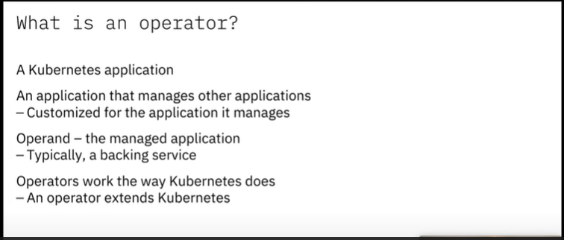
What is an Kubernetes Operator?

Slide 56
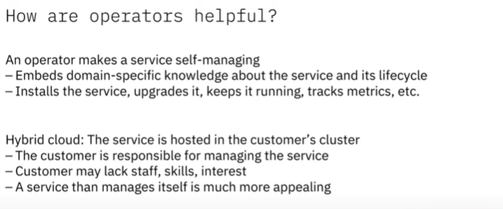
Benefits

Slide 57
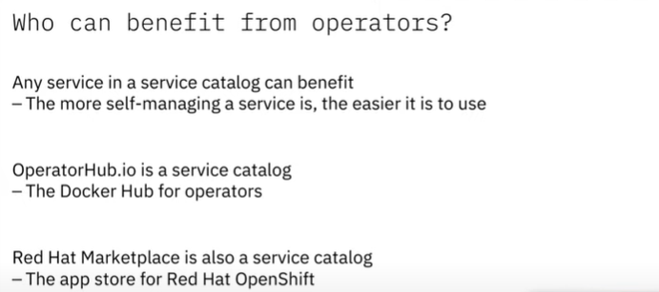
Who can benefit?

Slide 58
Example Operator
deploying an application on demand
taking and restoring backups of that application's state
handling upgrades of the application code alongside related changes such as database schemas or extra configuration settings
publishing a Service to applications that don't support Kubernetes APIs to discover them
simulating failure in all or part of your cluster to test its resilience
choosing a leader for a distributed application without an internal member election process

Slide 59
Why does Kubernetes need Operators?
Automate tasks
Makes sure the service keeps running
Self-managing
Manages stateful workload

Slide 60
Operator Components
An operator includes these components
Custom Resource Definition (CRD)
Defines a schema of settings
Custom Resource (CR)
Kubernetes API extension created by a CRD.
Controller
Configures the current state of the workload.

Slide 61
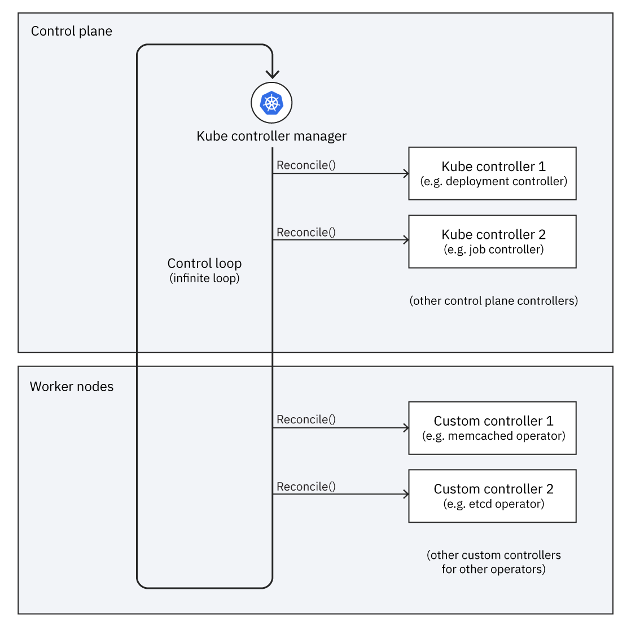
What do operators do?

Slide 62
How do I use an Operator?
Deploy the operator as a workload.
Can use Operator Hub to deploy an operator
Can Operator Life Cycle Manager to deploy an Operator.

Slide 63
Operator Technologies
Go
71% of operators from operatorhub.io are written in Go language.
Ansible
Good choice for infrastructure teams.
Helm
Helm operators are simpler to implement.

Slide 64
Operator SDK
Open source tools for Build, Test and Package operators.
Operator SDK is a framework makes writing operator easier
The operator SDK provides
High level API
Tools for scaffolding and code generation
Extensions to cover common Operator uses case.
SDK CLI enables you to scaffold a project.
Operand
Managed Workload
Managed Resources
Secondary resources
SDK uses Make commands
Make manifests
Make install
Make generate
Make docker-build
Make docker-push
Make deploy
Make undeploy

Slide 65
Operator Life Cycle Manager
Operator Lifecycle Manager (OLM) helps users install, update, and manage the lifecycle of Kubernetes native applications (Operators) and their associated services running across their OpenShift Container Platform clusters.
SDK installs the OLM
A set of cluster resources that manages the Operator Lifecycle.

Slide 66
OLM Features
Over-the-air updates and catalogs
Dependency Model
Discoverability
Cluster stability
Declarative UI Controls

Slide 67
Operator Framework
Open source project
Operator Framework includes
Operator SDK
Operator Lifecycle Manager
Operator Metering

Slide 68
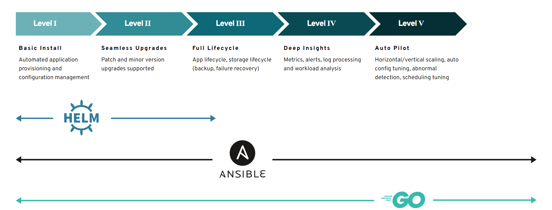
Capabilities

